Slide 1
Finding and Using Scholarly Resources
METR 3334 – Principles of Research and Communication in Meteorology
Amanda Schilling
STEM Librarian
Notes:
Before slideshow – introduce me, explain zoom chat and reactions
TURN ON LIVE TRANSCRIPT AND TELL LEARNERS

Slide 2
Agenda
By the end of this session, you should
Understand what library resources are available to support your research.
Know how to find relevant background information from OU Libraries catalog.
Know how to find relevant peer-reviewed papers in Google Scholar, Web of Science, and other subject-specific databases.

Slide 3
What question(s) do you have?
Write a question you want answered.
Research concept
Experimental technique
Weather/math/physics concept
Anything
We’ll use this later
Example: How does climate change influence extreme weather such as flooding, drought, and hurricanes?
Notes:
Questions that require more than a quick google search – something you want to UNDERSTAND.
Leave some space after each question - we’re going to be writing a bit more about each.
OR
Share worksheet!

Slide 4
Tools We’ll Use
Start at OU Libraries website
From there, we’ll access
Library catalog
Web of Science
Other subject databases
Notes:
Library site tour – login, hours, quick links, My Library
My Library – add Google Scholar, Web of Science, (subject specific?)
Zoom poll – what have you used?
Catalog search – record details, filters, different sources
Google Scholar – BRIEF
Web of Science – BRIEF – citation treeing

Slide 5
Different sources
Information you’re seeking | Relevant resource(s) | Where to look
General, background | Books, magazines | Library catalog, the web
Non-specialist | magazines | Library catalog, the web
Specialized, advanced, latest research | Journal articles, book chapters | Google Scholar, subject DB*
Research techniques, background on specific topic | Theses, dissertations | Library catalog, Google Scholar, subject DB*
*examples of subject databases – Web of Science, Earth, Atmospheric & Aquatic Science Collection, Meteorological & Geoastrophysical Abstracts.
Notes:
Poll – which tool to search for which information.
Which tool would you use to find the year Marie Curie was born? Google (internet search) OR Web of Science
Which tool would you use to find a full biography of MC? Library Catalog OR Google Scholar
Which tool would you use to find out what MC won the Nobel Prize for? Library Catalog OR Google
Which tool would you use to find journal articles that cite MC’s work? Web of Science OR Library Catalog
http://cwp.library.ucla.edu/Phase2/Curie,_Marie_Sklodowska@812345678.html#sip

Slide 6
Tools for searching
Search engines; e.g. Google
Use an algorithm
You search using full sentences
Academic databases; e.g. library catalog / Web of Science
Human indexed
You search using keywords, Boolean operators, filters

Slide 7
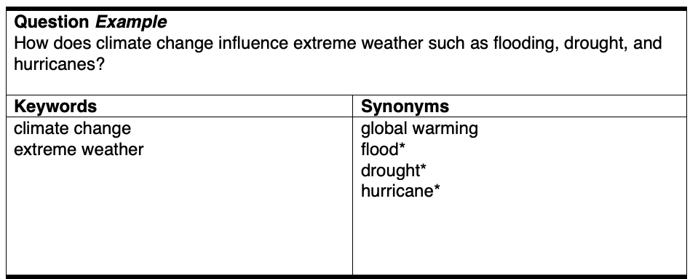
Keywords
Notes:
Let’s practice searching in an academic database.
Pull out the main words/phrases

Slide 8
Keywords
Notes:
Think about keywords you’ve seen used in the field, jargon, popular phrases – ALL these can be used in your search
General? Specific?
Wildcard to search root word and all forms of it

Slide 9
For next time
Install Zotero application AND browser plugin
zotero.org/download

Slide 10
Let me know how this went!
https://ou.libwizard.com/f/libvisit
Notes:
https://ou.libwizard.com/f/libvisit

Slide 11
Contact us!
Catherine Byrd – National Weather Center Librarian
email: nwclibrary@ou.edu
Amanda Schilling – STEM Librarian
email: amanda.schilling@ou.edu
appts. (virtual appts available): https://libcal.ou.edu/
Notes:
Amanda Schilling
Science Librarian
email: amanda.schilling@ou.edu
appts.: https://libcal.ou.edu/appointment/43601

